Slide 1


An Analysis on
Social Buzz’s
Content Categories
Notes:
Hello and welcome, my name is Divine Jude, today I will be presenting to you the results of the Data Analytics task.

Slide 2


Today's agenda
Project recap
Problem
The Analytics team
Process
Insights
Summary
Notes:
Today's agenda will be as follows:
1. We will recap the overall project to give a high level understanding of the business problem we're tackling and the specific requirements.
2. We will dive into the specific problem that we, the Data Analytics team, have been focusing on and will give some background as to why this is such a big problem.
3. After introducing the problem, I will go over the team responsible from our side in tackling this task.
4. I will then go over the high-level process that we followed to complete this task, so that you have complete clarity in how we tackle these kinds of tasks.
5. Finally, I will go over the all important results and I will present them as a series of insights and visualization's from our analysis.
To wrap up, I will summarize and be open for any questions.

Slide 3


Social Buzz is a social media and content creation company founded in 2010 by two former engineers. They have a unique approach to content, keeping all users anonymous and tracking user reactions on every piece of content. They have rapidly grown to over 500 million active users each month, and are now looking to bring in external expertise to help them complete an IPO by the end of next year, manage their scaling process effectively, and learn data best practices from a large corporation.
Our engagement with Social Buzz will include a 3 month initial project, where we will:
Conduct an audit of their big data practice,
Make recommendations for a successful IPO, and
Analyse their content categories to highlight the top 5 categories with the largest aggregate popularity.
Project Recap

Slide 4


Problem
Due to the rapid growth and digital nature of Social Buzz’s core product, the amount of data that they create, collect and must analyze is huge. Every day over 100,000 pieces of content and 36,500,000 pieces of content per year, ranging from text, images, videos and GIFs are posted. All of these constitute highly unstructured data that requires expertise in handling. The client has reached a massive scale within recent years and does not have the resources internally to handle it.

Slide 5



ANDREW FLEMING
Chief Technology Architect
The Analytics team
MARCUS ROMPTON
Senior Principal
DIVINE JUDE (ME)
Data Analyst

Slide 6

Data Understanding
Process
1
2
Data Extraction
3
Data Modelling
4
Data Analysis
5
Recommendations
Notes:
How did we tackle this problem?
Well we approached it in 5 steps:
Data Understanding: Understand the data model and domain of your business
Data Extraction: Architected what an ideal dataset should look like for this problem and extracted it from the relevant data sources
Data Modelling: Process and model the data into a dataset that can precisely answer the business questions and produce analytics.
Data Analysis: Use analytical expertise to uncover insights from the dataset and to produce visualizations to describe the insights.
Recommendations: Use insights to unlock business decisions and make recommendations on next steps

Slide 7


Insights
16
1897
May
Animal Posts
Month with most Posts
Unique Content Categories
Notes:
From your data we found that:
A total of 16 unique categories of posts across your sample dataset. This includes things such as Animals, science, healthy eating, technology, food, culture, travel, cooking, soccer, education, fitness, Studying, dogs, tennis, veganism, public speaking.
There were 1897 reactions from just the animal category alone.
And also the most common month for users to post was within January. This aligns with seasonal trends of social media users.

Slide 8
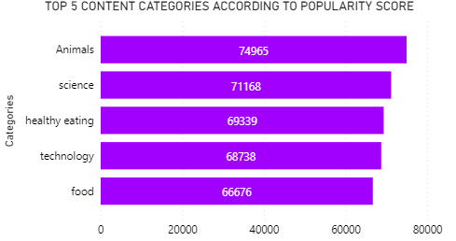
From our analysis you can see the top 5 most popular contents were Animals, Science, Healthy Eating, Technology, Food in descending order.. This data suggests that users are particularly interested in content related to animals, science, and healthy eating, with technology and food also being popular topics.
Notes:
Animals and science are broad categories that can encompass a wide range of subtopics, from cute animal videos and photos to scientific research and discoveries. Healthy Eating is another broad category that may include information about nutrition, diet, and wellness.
Technology is a broad and dynamic category that can include a wide range of topics, from the latest smartphones and laptops to cutting-edge research in fields like artificial intelligence and quantum computing. Food is another broad category that can encompass everything from recipes and cooking tips to restaurant reviews and food-related news.
It's worth noting that these are just general trends, and it's important to consider the specific interests of your target audience when creating and curating content. Additionally, it's worth to also consider other metrics like engagement, views, and shares to understand how much impact it makes on your audience.

Slide 9
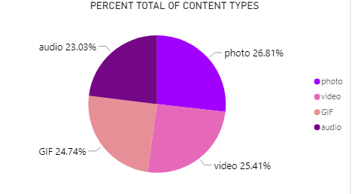
For the content types, Photo is the most favored content type. This could indicate that users engage with photos more frequently and for longer periods of time compared to other types of content.. This could be due to the visual nature of photos, which can be more attention-grabbing and easier to understand than audio or video.
Notes:
Additionally, photos can often convey a message or emotion more effectively than text alone. It's worth noting that there are many factors that can influence user engagement with different types of content, and further research would be needed to fully understand the reasons behind users' preferences.

Slide 10
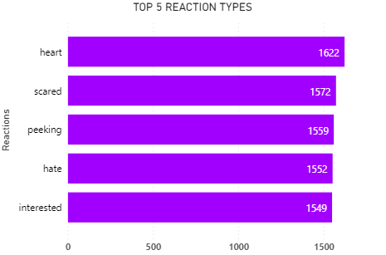
Additionally, from our analysis the top 5 content reactions were heart, scared, peeking, hate, interested this could convey that users tend to have strong emotional reactions to the content they are viewing. The heart reaction suggests that users find the content to be positive and likable, while the scared and peeking reactions may indicate that the content is suspenseful or intriguing. The hate reaction suggests that users have a negative reaction to the content, and the interested reaction suggests that users are paying attention and engaged with the content.
Notes:
These emotions could be used as an indicator of the type of content and audience that is resonating with your user base. For example, if a majority of your users are responding with heart reactions, it could indicate that your content is generally positive and well-received. If a majority of users are responding with hate reactions, it could indicate that your content may be controversial or polarizing.
It's worth noting that these reactions are just one aspect of user engagement and it's important to consider other metrics such as click-through rates and time spent on the content to get a more complete picture of user engagement.

Slide 11


ANALYSIS
Animals and science are broad categories that can encompass a wide range of subtopics, from cute animal photos and videos to scientific research and discoveries.
INSIGHTS
It's worth noting that these are just general trends, and it's important to consider the specific interests of your target audience when collecting and analysing contents.
Additionally, it's worth to also consider other metrics like engagement, views, and shares to understand how much impact it makes on your audience.
Social Buzz can leverage this information to
better understand their audience optimize their content strategy and to drive growth on their platform.
Summary

Slide 12


NEXT STEP
Based on the valuable insights obtained from this ad-hoc analysis, Social Buzz should consider partnering with Accenture to expand this analysis on a larger scale for real-time understanding of the business and to deliver even more value

Slide 13

Thank you!
ANY QUESTIONS?

